Slide 1
The Bulk Forming Processes: Rolling
Lecture 15

Slide 2
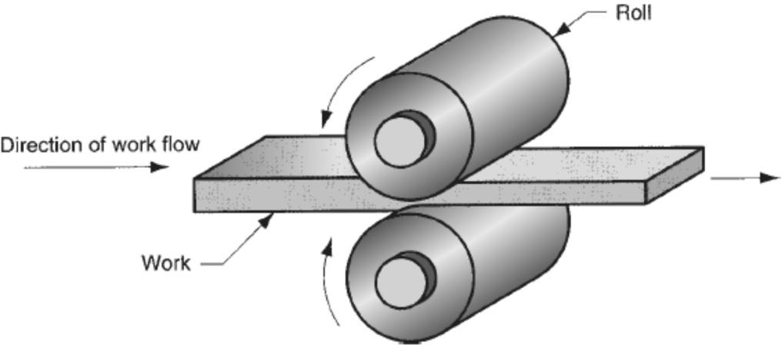
Rolling Process
Rolling is a metal forming process in which the thickness of the work is reduced by compressive forces exerted by rolls rotating in opposite directions.
Important terminologies:
Bloom: It has a square cross-section, 150 mm x 150 mm or more.
Slab: It is rolled from an ingot or a bloom and has a rectangular cross-section of 250 mm width or more and a thickness of 40 mm or more.
Billet: It is rolled from a bloom and has a square cross-section, with dimensions of 40 mm on a side or more.
Flat rolling

Slide 3
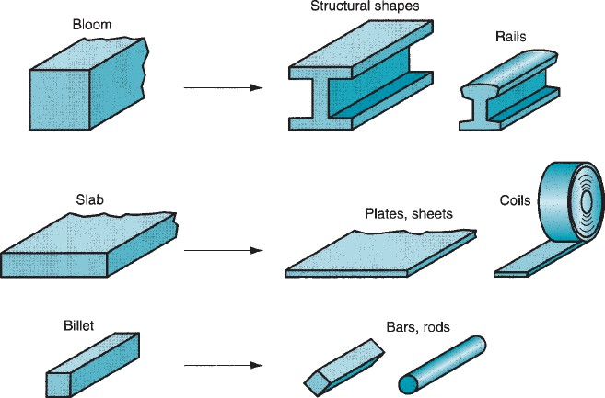
Blooms are rolled into structural shapes like rails for railroad tracks.
Rolling Process and Applications
Billets are rolled into bars or rods. They become raw materials for machining, wire drawing, forging, and extrusion, among other processes.
Slabs are rolled into plates, sheets, and strips. Hot-rolled plates are commonly used in shipbuilding, bridges, boilers, and welded structures for various heavy machinery, as well as in the production of many other products.
The plates and sheets are further reduced in thickness by cold rolling to strengthen the metal and permit a tighter tolerance on thickness.

Slide 4
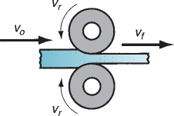
Rolling Mills
Two High Rolling Mill
This type of rolling mill consists of two rolls rotating in opposite directions.
Roll diameters: 0.6 to 1.4 m
Types: either reversing or non-reversing.
Non-reversing mill: rolls rotate only in one direction, and the slab always moves from the entry to the exit side.
Reversing mill: direction of roll rotation is reversed, after each pass, so that the slab can be passed through in both directions. This permits continuous reductions to be made through the same pairs of rolls.

Slide 5
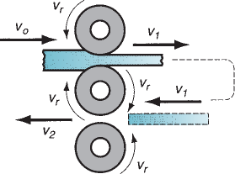
Three High Rolling Mills
For a single pass, two rolls are used.
The roll direction can not be changed.
The top two rolls are used for the first reduction, and the sheet is shifted to the bottom two rolls, and further reduction is done.
Disadvantage: an automated mechanism is required to shift the slab

Slide 6
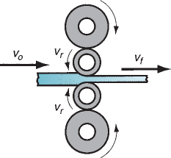
Four High Rolling Mill
This consists of two small rolls for thickness reduction and two large backing rolls to support the small rolls.
The small rolls will reduce the roll force required as the roll-sheet contact area will be reduced.
The large backing rolls are required to reduce the elastic deflection of small rolls when the sheet passes between them.
Four high rolling mills

Slide 7
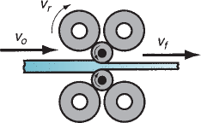
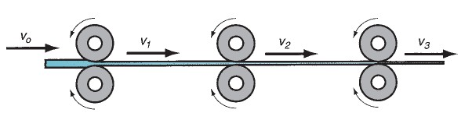
Cluster Rolling Mills uses small rolls for rolling purposes
Tandem Rolling Mill
Consists of a series of rolling stations of the order of 8 to 10.
In each station, thickness reduction is given to the sheet. With each rolling station, the work velocity increases.
Fully used in industry practice, along with the continuous casting operation.
Results in a reduction in floor space and shorter manufacturing lead time.

Slide 8


